Slide 1
SAP Gateway Day 1 - Agenda
What is SAP Gateway?
Introduction about SAP Gateway
SAP Gateway Overview and Architecture
SAP Gateway – Deployment options
REST Architecture

Slide 2
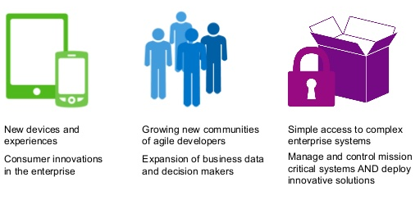
SAP Gateway
What is SAP Gateway?
Any Environment, Any Device, by Any Developer
SAP Gateway lets you empower users with secure, personalized solutions that leverage and extend your existing SAP infrastructure, all with security, robustness, agility, and efficiency. SAP Gateway lets you meet the changing needs of your business at the speed of business by enabling People agility, System agility and Process agility.

Slide 3
Capabilities of SAP Gateway
Open - Any Device, Any Experience, Any Platform
People - Optimized for User Interaction Scenarios
Timeless - Non disruptive, any SAP Business Suite version
Developers - Simple APIs, no SAP knowledge, any tool
Standards - Based on REST, ATOM/OData
Opening the doors for millions of developers to create solutions connecting to SAP
Increase workforce productivity
Reduces Complexity , skill set requirements and deployment barriers
Shorten development times/cycles
Engage all developers with their choice of development tools
It offers connectivity to SAP applications using any programming language

Slide 4
Benefits of SAP Gateway
Hides the technical complexities of your SAP system landscape behind a single interface that is easy-to-use and non-proprietary.
Makes your SAP business data and functionality accessible to any external device.
Communicate using the HTTP(S) protocol.
Understand OData messages.
Provides Service Provisioning tools that allow the quick REST-enablement of existing ABAP functionality.
Provides plug-ins for well known IDEs such as Eclipse, Visual Studio 2010 and XCode.

Slide 5
Focusing area of SAP Gateway
Any external business application. E.G. Microsoft Office applications via a .Net (or even VBA) interface
Desktop machines using Web-based applications running PHP or Java or Ruby, etc.
Native applications on mobile devices E.G. iPad/iPhone or an Android device or a Blackberry.
Embedded devices such as manufacturing robots or route planning software in Satellite Navigation systems.
Any other business scenario you can think of involving some programmable device that can speak HTTP(S).
The SAP Gateway interface can be used to supply the SAP Business Data to any programmable device that can speak HTTP(S).

Slide 6
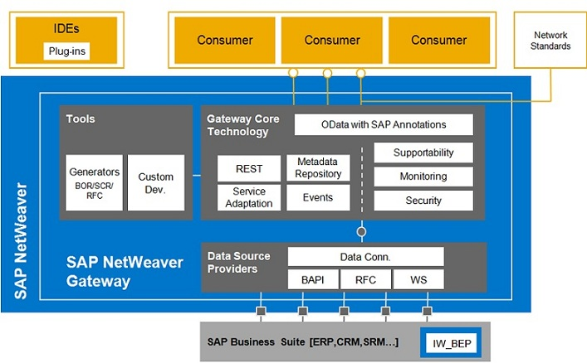
SAP Gateway Architecture

Slide 7
Deployment Options
HUB Architecture:
Gateway server functionalities are only used on one dedicated server, the hub system. The services are deployed on the backend systems and are registered on the server. The Gateway service is thus deployed in the Gateway backend systems where either IW_BEP is deployed systems or that are running on top of 7.40 leveraging the core component SAP_GWFND.
Embedded Architecture:
In this case the services are registered as well as published in the SAP Business Suite backend system.

Slide 8
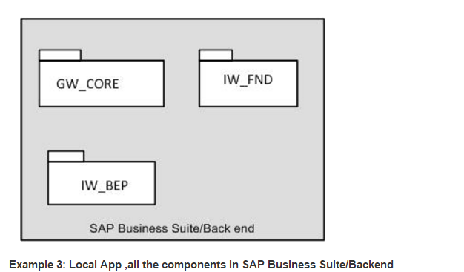
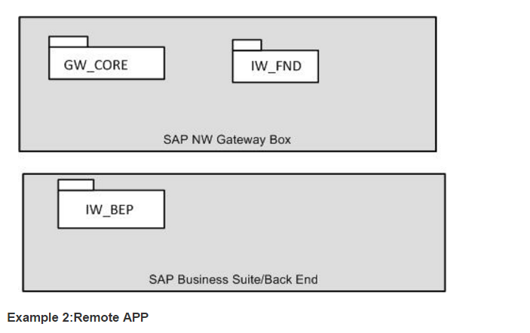
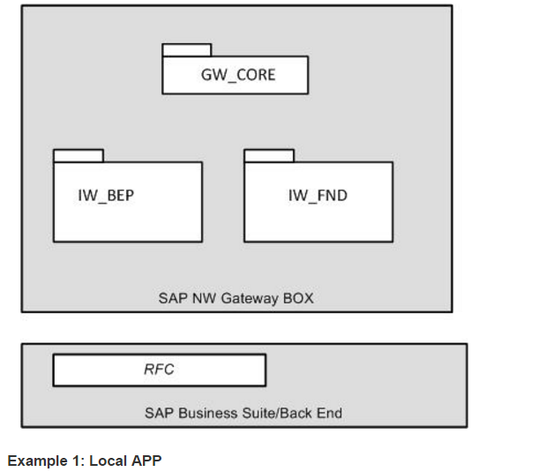
Gateway Components

Slide 9
Question & Answers
What does REST stands for?
Representational State Transfer
Which architecture SAP recommends?
SAP recommends Central HUB architecture as a first option, and again it depends upon the client landscape, which one to implement.
How is SAP Gateway different from Web services?
Web services are based on SOAP services and SAP Gateway is REST-based. SAP Gateway focuses on consumption scenarios and SOAP is more process-to-process and machine-to-machine.
Security Level in SAP Gateway?
SAP Gateway supports
- Browser Based SAML 2.0 Authentication.
- x.509 Client Certificate authentication
- SAP Logon tickets(SSL)
- Basic Authentication
SAP Net weaver Gateway Vs SAP Gateway
Only the calling name has been changed, and the architecture remains the same.

Slide 10
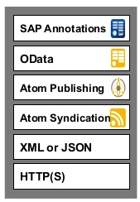
What is Open Data Protocol
OData is Microsoft developed extension to the Atom Publishing and Atom syndication Standards, which in turn are based on XML and HTTP(S).
It is Standardized protocol, built over existing HTTP and REST protocols supporting CRUD(Create, Read, Update and Delete) operations.
We can call it as ODBC Web.
It can be used freely without the need for a license or contract.
It uses ATOM+XML or JSON.
REST-based architecture.

Slide 11
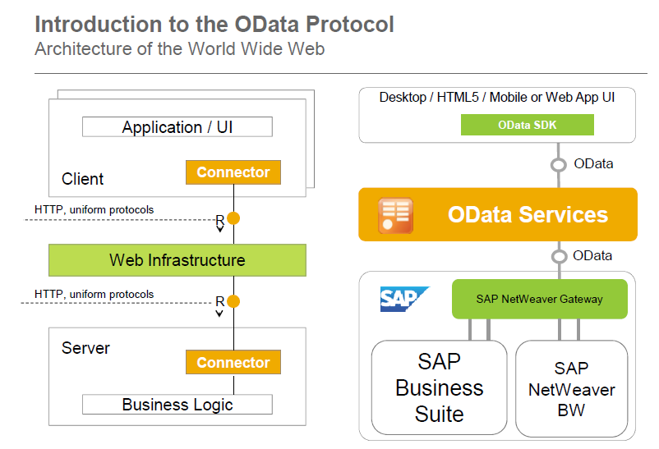
OData Protocol: WWW Architecture

Slide 12
REST Architecture
REST is an architectural framework and methodology which is based on addressability, statelessness, connectedness and uniform interface.
OData is an implementation of REST.
HTTP(S) – An Implementation of the REST constraints:
HTTP(S) is the protocol that drives the World Wide Web
A Server-side resource can be manipulated in four basic ways.
These four basic REST operations have given rise the acronym CRUD.
REST Operation | HTTP Method
Create Resource | POST
Retrieve one or more Resources | GET
Update Resource | PUT
Delete Resource | DELETE

Slide 13
SAP Gateway Day 2 - Agenda
Structure of an Odata service
Introduction about SAP Gateway
SAP Gateway Overview and Architecture
SAP Gateway – Deployment options
REST Architecture

Slide 14
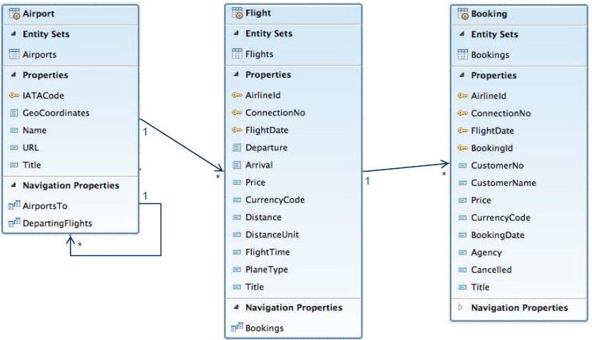
OData Service – Data Model & Structure
An Entity Data Model (EDM) is the starting point for building an OData service. An EDM describes
both the data structures and their inter-relationship used in a business scenario.

Slide 15
Definitions
An Entity type can be considered as data type that contains details of specific type of data.
For example: Customer, Supplier, Sales Order, Employee etc.
An Entity set is nothing but a collection of Entity type.
Entity Key is used to uniquely identify an Entity Type.
For example: Employee number , Sales Order number
Association is simply relation ship between two or more Entity types
For example: Products to its Manufacturer
An entity set Product can be associated with an entity set Manufacturer in an OData metadata.
Navigation Property is a property set on an entity type to understand the associations of the entity type.

Slide 16
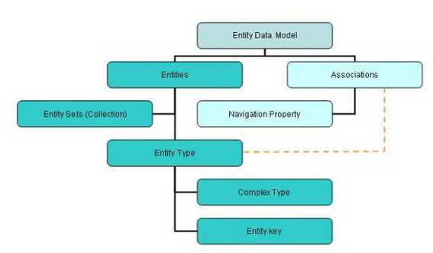
Metadata of OData
The metadata of OData message can be summarized as follows.
Refer to this blog: http://www.odata.org/

Slide 17
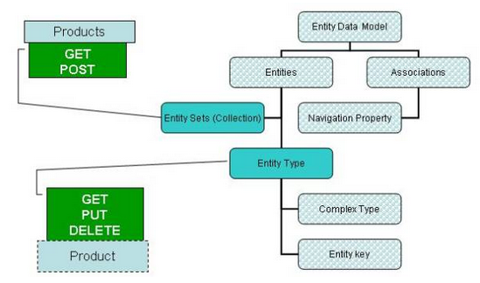
Possibility operations
We can do a GET and POST request on an Entity Set while GET, PUT and DELETE can be done on an Entity.

Slide 18
Service Operations
Service Operations:
- GetEntity
we can refer to as work area in ABAP
- GetEntitySet
we can refer to as internal table in ABAP
- Create
We can create only single record at once.
- Update
We can single only record at once.
- Delete
We can delete only single record at once.

Slide 19
Queries to manipulate the data
$format : This query allows us to change the format of data.
URI: http://services.odata.org/OData/OData.svc/Suppliers?$format=json
$top : This query helps to limit the data returned by the service.
URI: http://services.odata.org/OData/OData.svc/Categories?$top=1
$Skip :This can be treated as opposite to $top.
URI: http://services.odata.org/OData/OData.svc/Products?$skip=2
$inlinecount: This will return the total number of records as part of response payload.
URI: http://services.odata.org/OData/OData.svc/Suppliers?$inlinecount=allpages
$orderby :It is used to sort the records returned by service.
URI: http://services.odata.org/OData/OData.svc/Products?$orderby=Price desc

Slide 20
Queries to manipulate the data
$expand :This we found as very helpful query to reduce the number of calls we need to make to access a particular set of data. Say, if you want to return all the products along with their category, use the URL provided in the example
URI: http://services.odata.org/OData/OData.svc/Products?$expand=Category
$filter : This can be compared to ‘where’ query in SQL. Lets say we want to get all the products with greater than 3, below is the URI
URI: http://services.odata.org/OData/OData.svc/Products?$filter=Rating gt 3
$select :As is any SQL query, this query option can be used to select specific or all fields of an Entity set or Entity. A simple example, lets say the requirement for which is for us to return the fields rating and Price of a Product with ID = 3
URI: http://services.odata.org/OData/OData.svc/Products(3)?$select=Rating,Price

Slide 21
How to play with URI’s
More examples:
Get me the three of the best rated products
URI: http://services.odata.org/OData/OData.svc/Products?$top=3&$orderby=Rating desc
Now get me the next three best rated products.
URI: http://services.odata.org/OData/OData.svc/Products?$top=3&$skip=3&$orderby=Rating desc
Get me the count of Products with the Price greater than or equal to 20?
URI: http://services.odata.org/OData/OData.svc/Products?$inlinecount=allpages&$filter=Price ge 20

Slide 22
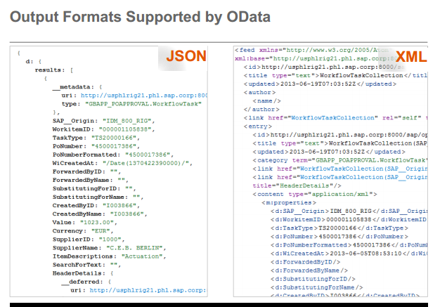
Why OData
Why OData instead of REST ?
We have seen how OData provides you with a consistent uniform standard way of describing the data and the data model. That precisely gives it an edge over REST.

Slide 23
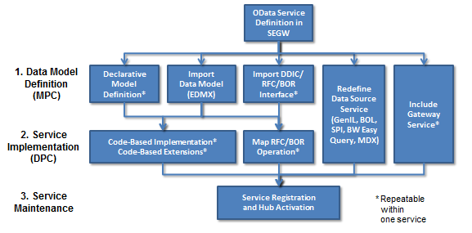
Gateway Service Builder Tool
Gateway Service Builder (transaction "SEGW") is available as of Release 2.0 Support Package 4/5 and it greatly accelerates the OData service development process. In many cases you don't even need to write a single line of ABAP code - unless of course you prefer to do so. It is no longer mandatory that you have deep ABAP OO skills.
In Service Builder we need to do follow below three steps to build an OData service:
Define or import the data model
Implement or generate the runtime logic for the service operations
Activate and run the service
The picture shows the various options
that are covered in SEGW:

Slide 24
SEGW
Need to understand below terms in SEGW transaction
- Entity Type
- Entity Set
- Association
- Navigation
- Referential Constraints
- MPC( Model Provider Class )
- DPC( Data Provider Class )

Slide 25
SAP Gateway Day 3 - Agenda
Odata Query Options & Parameters
Filtering & Projecting in Odata result set
Sorting in Odata result set
Client-side Pagination
Counting & Formatting

Slide 26
Odata Query Options & Parameters
Filtering and Projecting ($filter and $select) : The $ﬁlter statement can be compared with the where clause in the usual SQL syntax. The $select statement is basically the same as the SELECT keyword in normal SQL.
Benefits:
Less data is transferred
Depending on the data structure in the SAP Business Suite backend system, less data might have to be consumed. For example, if the data is stored in a view comprising multiple database tables.
Syntax: http://<server>:<port>/sap/opu/odata/sap/<service_name>/ProductsSet?$select=ProductId,Name,Description
Syntax :
http://<server>:<port>/sap/opu/odata/sap/<service_name>/ProductsSet?$filter=ProductId eq ‘HT-1000’
$filter = <fieldname> <operator> <value> , where:
<fieldname> is the name of the field.
<operator> must be from the list of supported operators.
<value> can be a string value and should be enclosed in quotation marks (‘value’).

Slide 27
Odata Query Options & Parameters
Sorting ($order by) : Query option $orderby adds sorting capabilities to the SAP gateway OData service. So that we can be able to order the OData service feed/collection based on the fields available in the Entity Type set.
Example : A gateway OData service is getting all the products from the back-end system, but we don’t want to see the products in the order they retrieved, and we want to apply orderby on the OData service so that we get required products in required order.
For example, we want to order the all products by its “Price” in descending.
Syntax : http://<server>:<port>/sap/opu/odata/sap/<service_name>/ProductsSet?$orderby=Price desc
$orderby = <fieldname> <sortorder> , where:
<fieldname> is the name of the field.
<sortorder> desc/asc

Slide 28
Odata Query Options & Parameters
Client-Side Paging ($top, $skip, and $inlinecount) : Query option $top and $skip are used to restrict the amount of data retrieved from back-end system.
Client side paging is possible by using this query option $top=n query option will retrieve the top n records from the OData service feed/collection. $skip=x will go with $top=n query option, it will retrieve top n records by skipping the first x records from the OData service feed/collection.
Syntax
http://<server>:<port>/sap/opu/odata/sap/<service_name>/ProductsSet?$top=5
http://<server>:<port>/sap/opu/odata/sap/<service_name>/ProductsSet?$top=5&skip=3
Query option $inlinecount is used to get the overall count of feed/collection together with the entity set collection data.
Syntax
http://:/sap/opu/odata/sap//ProductsSet?$inlinecount=allpages

Slide 29
Odata Query Options & Parameters
Counting ($count) : The $count service request returns the number of records in a collection or if the collection has a filter, the number of records matching the filter.
Syntax: http://<server>:<port>/sap/opu/odata/sap/<service_name>/ProductsSet?$count
Inlining ($expand) : OData query option $expand is used to read multiple entities or entity sets in a single service call instead of two different calls. Prerequisite, entity sets which are used should be associated
Syntax : Single Sales Order and its line items http://<server>:<port>/sap/opu/odata/sap/<servicename>/SalesOrders(‘123’)?$expand=ToOrderItems
Syntax: Multiple Sales Order and their line items http://<server>:<port>/sap/opu/odata/sap/<servicename>/SalesOrders?$expand=ToOrderItems
where $expand = <Navigation_Property_Name>

Slide 30
Odata Query Options & Parameters
Formatting ($format) : Query option $ format can be used to convert the Odata result into different formats like JSON, XML etc
Syntax: http://<server>:<port>/sap/opu/odata/sap/<service_name>/ProductsSet?$format=json
$ (Select) : The $select statement is basically the same as the SELECT keyword in normal SQL.
Syntax: http://<server>:<port>/sap/opu/odata/sap/<service_name>/ProductsSet?$select=ProductId,Name,Description

Slide 31
SAP Gateway Day 4 - Agenda
Code Push Down – Data centric approach
Basics of Core Data Services (CDS)
Features & Advantages of CDS Views
CDS View Definition
CDS View with Joins

Slide 32
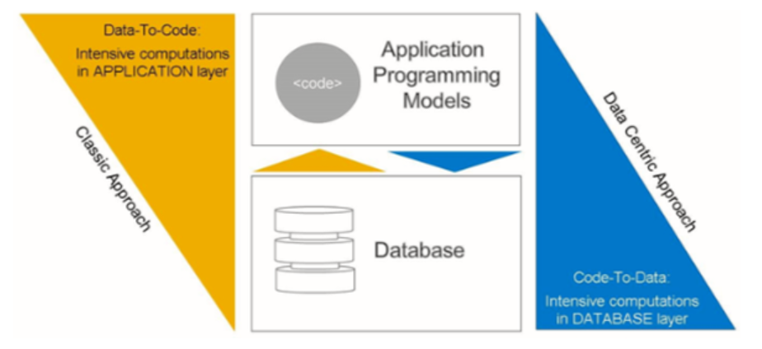
Code Push Down – Data centric approach
The SAP HANA platform combines in-memory software with hardware from leading SAP partners.
Adding SAP HANA technology to certified database hardware enables not only significant acceleration of existing applications, but also the development of completely new applications that were not previously possible.
To leverage the strengths of SAP HANA, applications follow the “code to data” paradigm in which calculation logic is pushed down from the application server to the database server.
The SAP HANA database then performs the calculations and sends the resulting data set back for use by an application.

Slide 33
Introduction to Core Data Services (CDS) View
CDS stands for Core Data Services.
A view is an entity that is not persistent; it is defined as the projection of other entities.
CDS View is reusable data models on the database.
It is a data model that represents framework of what relationships are in a database.
To take advantage of SAP HANA for application development, SAP introduced a new data modeling infrastructure known as core data services.
With CDS, data models are defined and consumed on the database rather than on the application server.
The rule-of-thumb is simple:
Do as much as you can in the database to get the best performance.

Slide 34
Introduction to Core Data Services (CDS) View
A CDS view is defined for existing database tables and any other views or CDS views in ABAP Dictionary .
CDS is a data modeling infrastructure for defining and consuming semantic and reusable data models on the database, rather than on the ABAP server, regardless of the database system used
Technically, it is an enhancement of SQL which provides you with a data definition language (DDL) for defining semantically rich database tables/views (CDS entities) and user-defined types in the database.
CDS entities and their metadata are extensible into the ABAP Data Dictionary and the ABAP language.
Code Push Down – Data centric approach

Slide 35
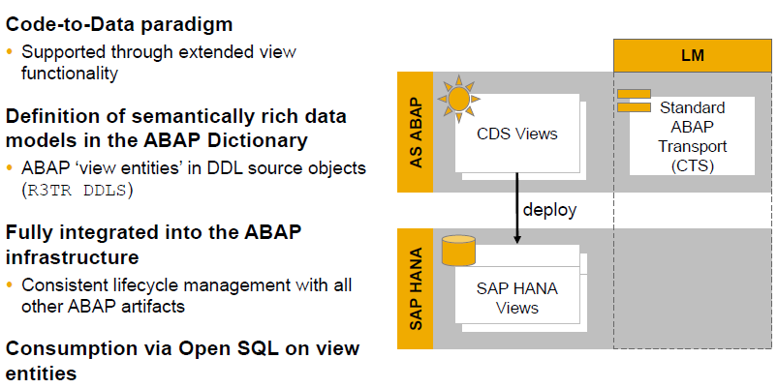
Features of Core Data Services (CDS) View

Slide 36
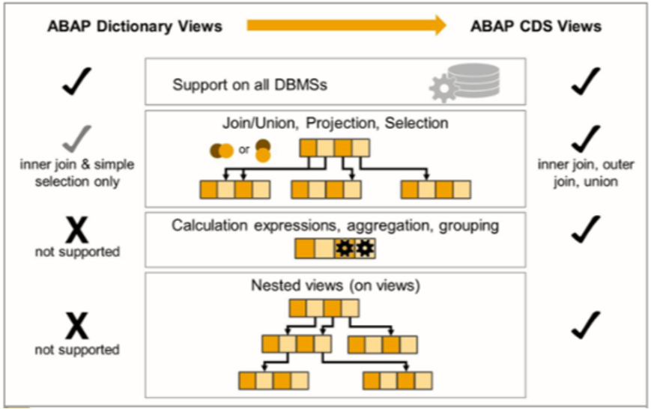
ABAP Dictionary Views vs. ABAP CDS Views

Slide 37
Advantages of CDS
Semantically rich data models
CDS builds on the well-known entity relationship model and is declarative in nature, very close to conceptual thinking.
Compatibility across any database platform
CDS is generated into managed Open SQL views and is natively integrated into the SAP HANA layer.
Efficiency
CDS offers a variety of highly efficient built-in functions — such as SQL operators, aggregations, and expressions — for creating views.
Extensibility
Customers can extend SAP-defined CDS views with fields that can be automatically added to the CDS view

Slide 38
Definition of CDS VIEW
The statement DEFINE VIEW is used to create the CDS DDL in ABAP.
This is done in the CDS source code of a CDS data definition in the ABAP Development Tools (ADT)
Definition is only possible with ABAP Development Tools in Eclipse/HANA
Studio .
CDS view cannot be created via transaction SE11.
CDS views can be developed and maintained in SAP HANA studio and in ABAP in Eclipse

Slide 39
CDS View Definition
Definition of the CDS consists of
View name
Semantic information (key field)
Projection List
Aliases
Projection List :
Client Dependency
Semantic Information (Key)
Aliases
Aggregation
Literals
Arithmetic Expressions
Conditional Expressions

Slide 40
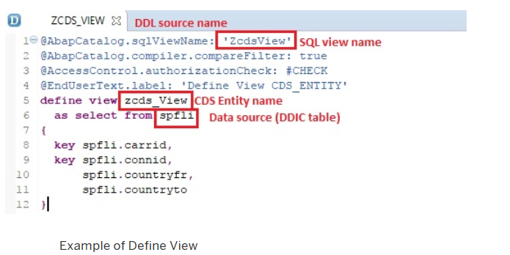
Simple CDS View

Slide 41
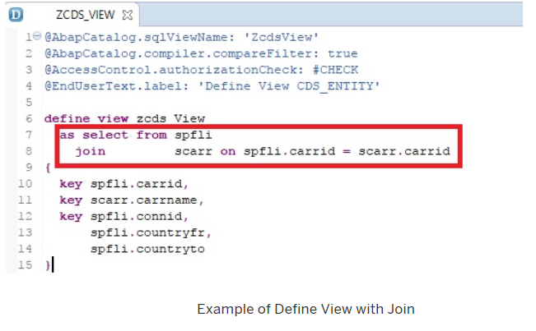
CDS View with Join

Slide 42
Demo
Create Simple CDS View, Preview it and consume it via Open SQL

Slide 43
CDS View Definition
Literal values:
C-sequence literals (Max length: 1333 )
Signed integer literals (4-Byte)
Aggregation functions:
MIN, MAX, COUNT, AVG, SUM
Alias required for function results
String functions:
LPAD,SCORE,LEFT,LTRIM,SUBSTRING
Alias required for function results

Slide 44
SAP Gateway Day 5 - Agenda
Types of CDS Views
CDS with Input Parameters
CDS View on View

Slide 45
Type of CDS Views
CDS View with Input Parameters
CDS View Extensions
View-on-View
CDS View without Input Parameters

Slide 46
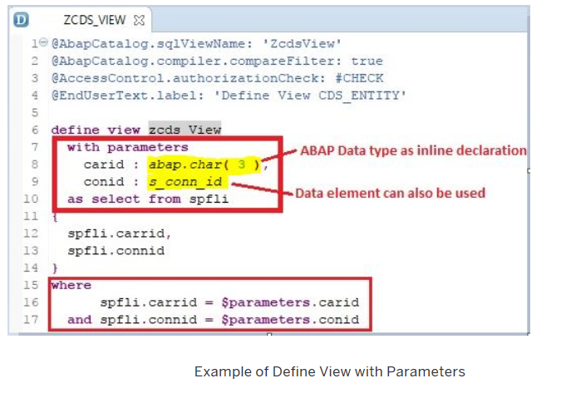
Type of CDS Views
CDS View with input parameters
To create Views with parameters key word used is With PARAMETER.
Comma-separated list of scalar input parameters and their corresponding type is to be mentioned.
Supported parameter types are as follows:
Predefined data type like abap.char(char_len)
Name of a data element

Slide 47
Demo
CDS View with Input Parameter

Slide 48
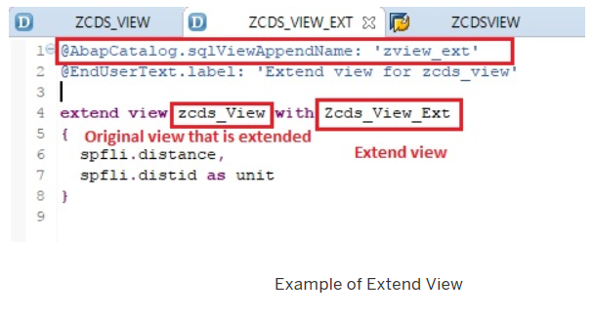
Type of CDS Views
CDS View Extensions
A CDS view can be extended by adding new fields .
To extend a CDS Base view, the key word used is EXTEND VIEW .
In the extended view, mention the new fields to be added separated by comma.

Slide 49
Demo
Create Base CDS View
Extend the above CDS View

Slide 50
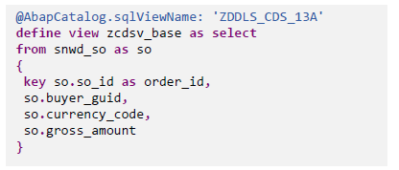
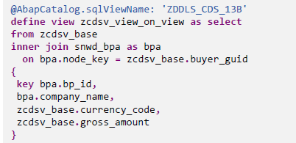
Type of CDS Views
View-on-View
Another important type of CDS view is View on View.
You can create CDS view on another CDS View(called as the Base View).
There is no restriction on the number of layers.

Slide 51
Demo
Create Base CDS View
Create View on the above Base View

Slide 52
SAP Gateway Day 6 - Agenda
Consumption of CDS in Fiori
CDS Annotations
Odata service generation from CDS

Slide 53
Consumption of CDS View
Consumption of CDS can be done in the following ways:
In a CDS View
By Open SQL
Data Preview (context menu in ADT)
SAP List Viewer
SAP NetWeaver Gateway (OData Model)

Slide 54
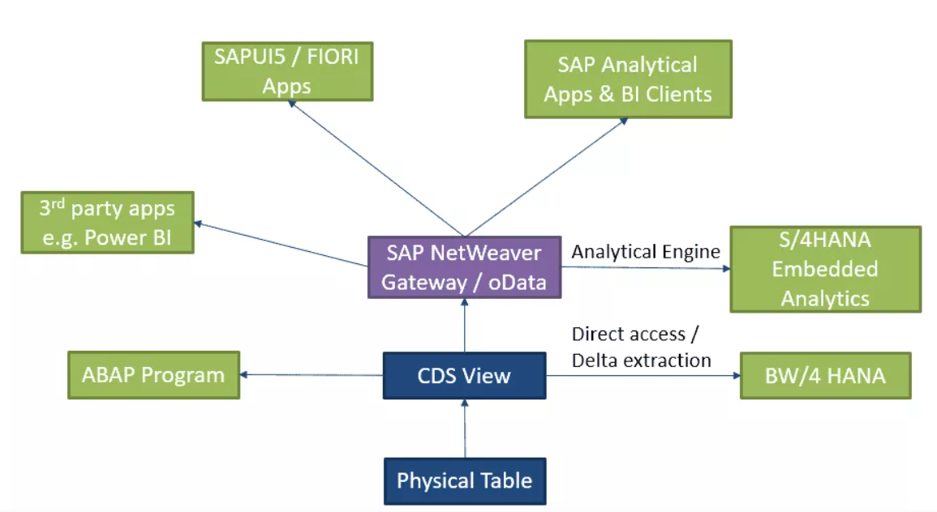
CDS Views consumption

Slide 55
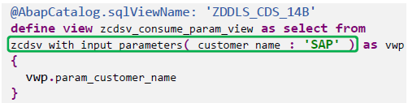
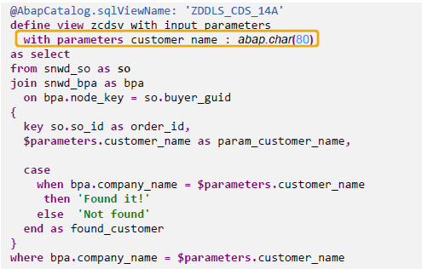
Consumption of CDS View
Consumption of CDS View in CDS View:
You can create CDS view on another CDS View(called as the Base View)
View on View is nothing but the consumption of CDS View in another View

Slide 56
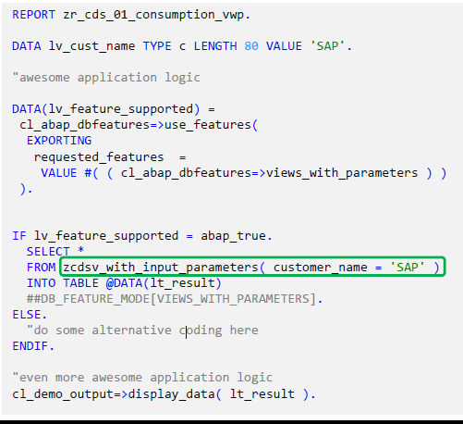
Consumption of CDS View
CDS View is consumed via OpenSQL using below 4 steps
Check if the feature is supported :abap_true
Provide (mandatory) input parameter(s) :Customer_name
Suppress syntax warning using the pragma ##
Provide a “fallback“ implementation / some error handling : ELSE

Slide 57
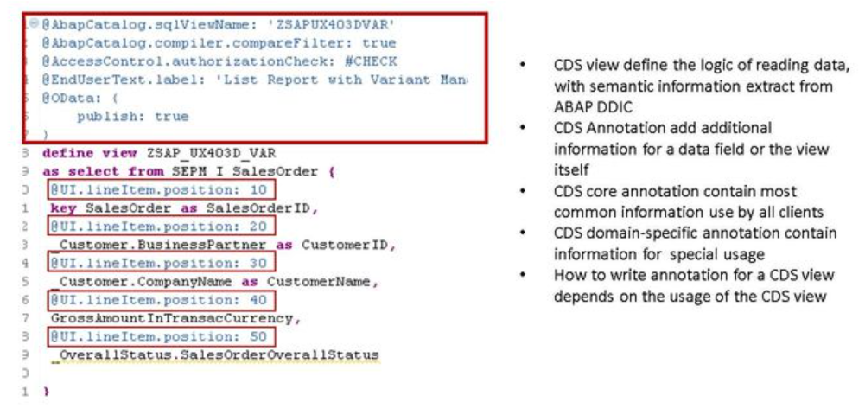
CDS Annotations

Slide 58
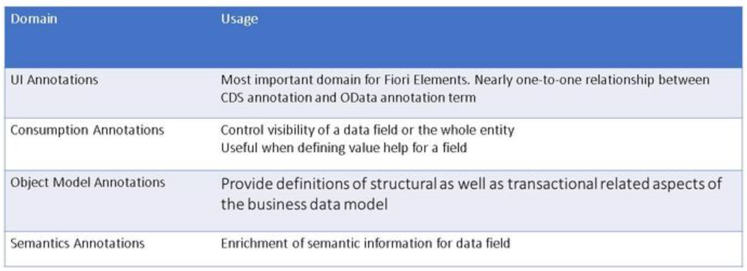
CDS Annotations
CDS annotations are extra information to describe the data, it let the consumer of CDS view know how to use data from the CDS view.
Annotations are grouped according to usage, this figure shows most relevant groups of association for Fiori Elements.

Slide 59
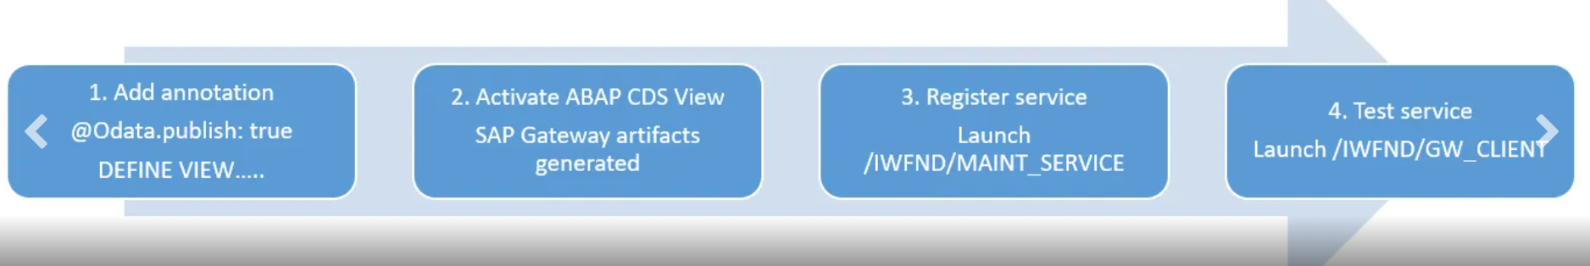
Odata Service generation from CDS
SAP Gateway OData service for an ABAP CDS view can be generated using annotation @OData.publish: true
CDS view should meet following rules for successful OData service generation:
No syntax errors in DDL source code.
At least one key element is defined in the SELECT list of the CDS view.
The name of the CDS view should not exceed 26 characters in length.

Slide 60
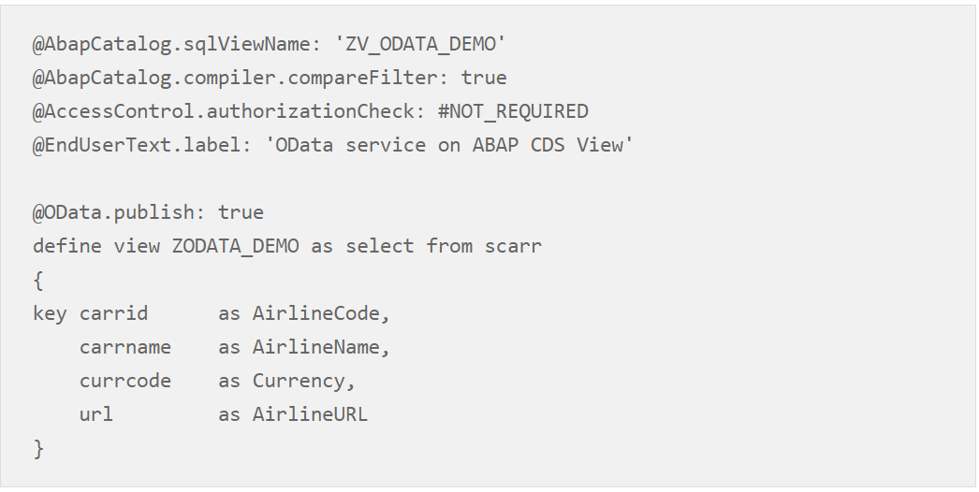
Odata Service generation from CDS
Add the annotation @OData.publish: true above the DEFINE VIEW statement

Slide 61
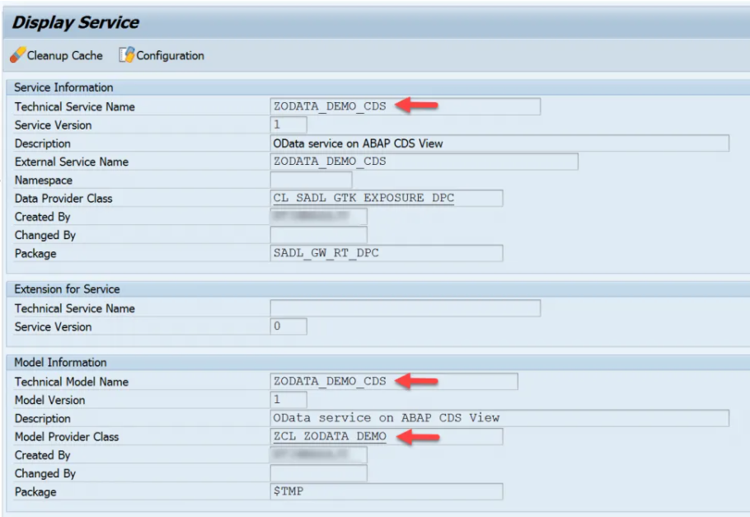
Odata Service generation from CDS
On activating the CDS view, following Gateway artifacts will be generated by the SADL framework in back-end server.
Technical service name artifact – <cds_view_name>_CDS.
Gateway Model artifact with name – <cds_view_name>_CDS.
ABAP class with name – CL_<cds_view_name>.
You can find all these artifacts in the transaction code – “/IWBEP/REG_SERVICE”

